Slide 1

Digital Transformation:
Riding the Emerging Technology Wave

Slide 2

https://www.linkedin.com/in/dr-michael-baron-78b8904b/

Slide 3
Digital Transformation Uncovered
Digital transformation refers to the integration of digital technology into all aspects of an organization, fundamentally changing how it operates and delivers value to its customers. It involves leveraging technological advancements to streamline processes, enhance efficiency, and innovate business models. (ChatGPT, 2024)

Slide 4


AI-Triggered Transformation

Slide 5

Digital Transformation Stages Business Processes
Stabilization
Standardization
Optimization
And Finally!!!! DIGITAL TRANSFORMATION!

Slide 6

Digital Transformation Principle #1
Coming to terms and understanding the current dynamic scenario with the focus on Creating Futures

Slide 7

Digital Transformation Principle 2
Establishing Protocols for operating in the BRAVE NEW WORLD

Slide 8

Digital Transformation Principle 3
Celebrating COVID-fuelled changes and unlocking potential of the Brave New World!

Slide 9
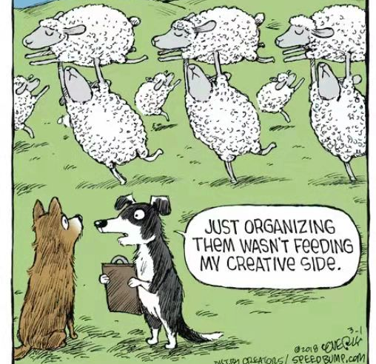
Digital Transformation Happens for a Reason

Slide 10

Thank you! Questions are Most Welcome!
https://www.linkedin.com/in/dr-michael-baron-78b8904b/
michael.baron@baronconsulting.com.au

Slide 11
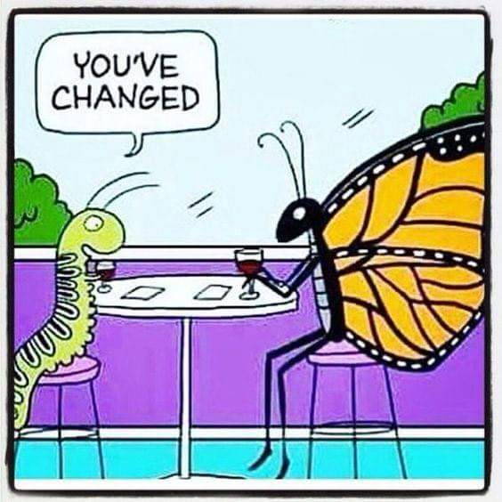
Digital Transformation Delays Impact
Procrastination Never Helps!

Slide 12

Establishing the DT Protocols

Slide 13

The ‘’Covid Factor’’
Covid Resulted in Break-down of Traditional Business Relationships!

Slide 14

My Recent Digital Transformation Projects
International College: Moving T&L online (Melbourne, Australia)
Schools: Creating Integrated Online Data Bank (Australia)
Interactive Trading Floor for Importing/Exporting Foods & Beverages (China)
AI-Driven IELTS Study Centre (Vietnam)

Slide 15

Digital Transformation Challenges: Facing the Music!
Difficulties in implementing a ‘’fully agile’’ approach (as defined by Braedley (2015)) : it hard to get all of the relevant stakeholders involved on a short notice.
At times, it felt like making Apple juice out of Oranges: Not all business processes are directly ‘’transferrable’’. Likewise, many of the Administrative processes have been structured around the traditional delivery environment
New Unconventional Projects are harder to plan for (Burgan & Burgan, 2014)
Even the ‘’Known-Unknowns’’ (as Discussed by Baron, 2016) are hard to accommodate for not to mention the ‘’Unknown Unknowns’’

Slide 16

The Lessons To Be Learned!
Expanded Risk Mitigation Plans
Prioritizing User-Centred Approaches
Pre-Release Testing for all of the Protocols
Involve Developers into the Initial Protocol Design Process Teams
Provide Adequate Support to all of the Stakeholders upon the E-Protocols Release

Slide 17

The Human Factor
IT IS NOT ONLY SIGNIFICANT BUT CRITICAL!

Slide 18
Systemic Failures of Traditional Business Models
Breakdowns of the Supply Chain
Deregulated Marketplaces
Lack Of Operational Efficiency and Global Scope

Slide 19
The Technology Wave
Artificial Intelligence (AI) and Machine Learning (ML):
Internet of Things (IoT):
Blockchain: Augmented Reality (AR) and Virtual Reality (VR):
Robotic Process Automation (RPA):

Slide 20
The Moment of Futurism
Digitalization of the Marketplaces & Society will remain an ongoing process
Optimal Automation of Business Processes
Increasing AI Deployment
World without Borders

Slide 21
Thank you
Questions, Comments & Remarks are most welcome!

